Slide 1
Simpson’s 1/3rd Rule of Integration

Slide 2

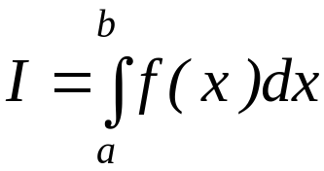
What is Integration?
Integration
y
f(x)
The process of measuring the area under a curve.
Where:
f(x) is the integrand
a= lower limit of integration
b= upper limit of integration
a
b
x
http://numericalmethods.eng.usf.edu

Slide 3
Simpson’s 1/3rd Rule
http://numericalmethods.eng.usf.edu

Slide 4
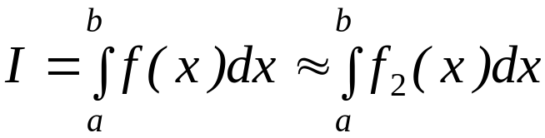


Basis of Simpson’s 1/3rd Rule
Trapezoidal rule was based on approximating the integrand by a first
order polynomial, and then integrating the polynomial in the interval of
integration. Simpson’s 1/3rd rule is an extension of Trapezoidal rule
where the integrand is approximated by a second order polynomial.
Hence
Where is a second order polynomial.
http://numericalmethods.eng.usf.edu

Slide 5
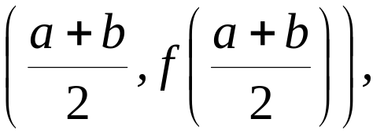



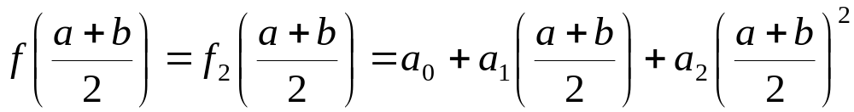

Basis of Simpson’s 1/3rd Rule
Choose
and
as the three points of the function to evaluate a₀, a₁ and a₂.
http://numericalmethods.eng.usf.edu

Slide 6
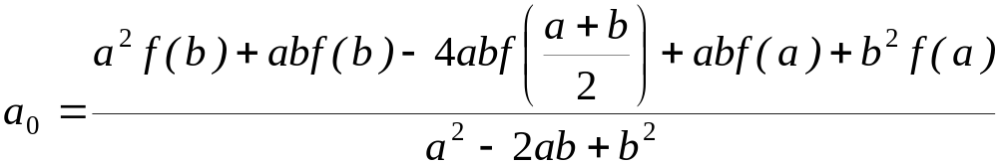
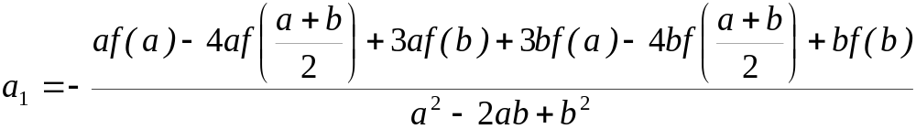
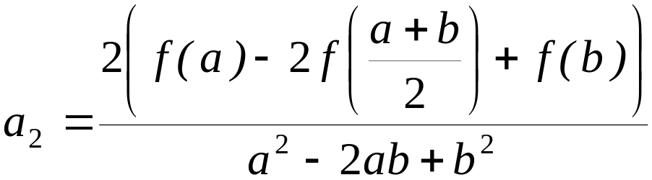
Basis of Simpson’s 1/3rd Rule
Solving the previous equations for a₀, a₁ and a₂ give
http://numericalmethods.eng.usf.edu

Slide 7
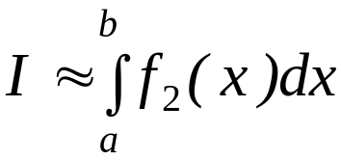
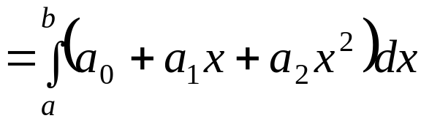
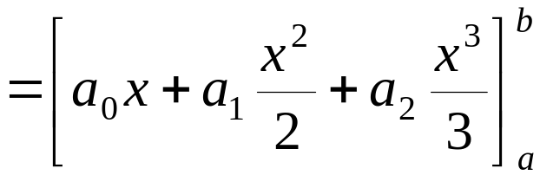
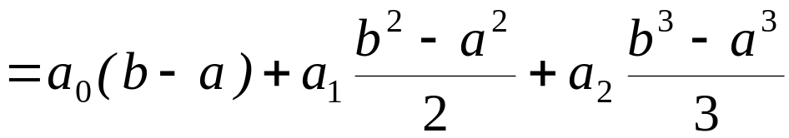
Basis of Simpson’s 1/3rd Rule
Then
http://numericalmethods.eng.usf.edu

Slide 8
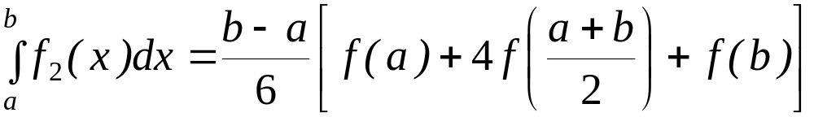
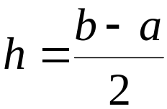
Basis of Simpson’s 1/3rd Rule
Substituting values of a₀, a₁, a ₂ give
Since for Simpson’s 1/3rd Rule, the interval [a, b] is broken
into 2 segments, the segment width
http://numericalmethods.eng.usf.edu

Slide 9
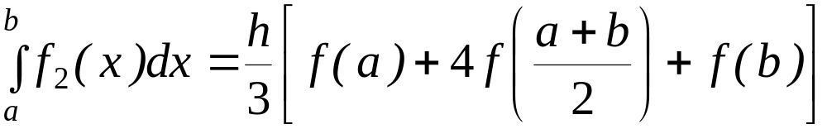
Basis of Simpson’s 1/3rd Rule
Hence
Because the above form has 1/3 in its formula, it is called Simpson’s 1/3rd Rule.
http://numericalmethods.eng.usf.edu

Slide 10
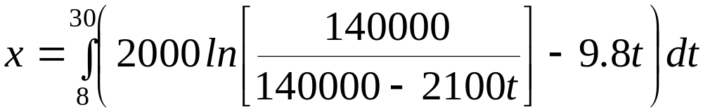


Example 1
The distance covered by a rocket from t=8 to t=30 is given by
a) Use Simpson’s 1/3rd Rule to find the approximate value of x
b) Find the true error,
c) Find the absolute relative true error,
http://numericalmethods.eng.usf.edu

Slide 11
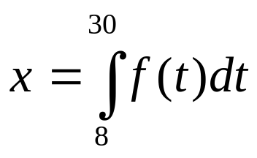
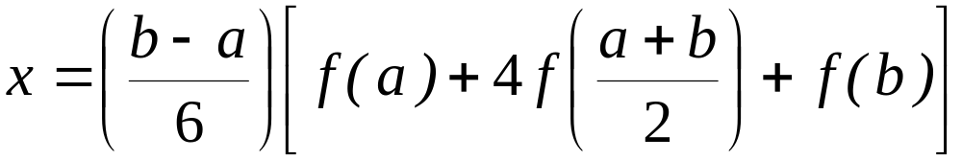
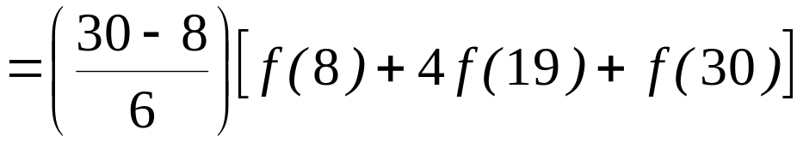
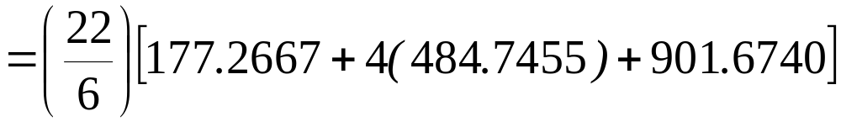

Solution
a)
http://numericalmethods.eng.usf.edu

Slide 12



Solution (cont)
b) The exact value of the above integral is
True Error
http://numericalmethods.eng.usf.edu

Slide 13
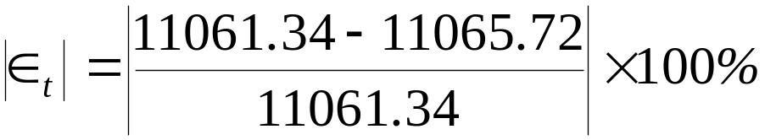

Solution (cont)
c) Absolute relative true error,
http://numericalmethods.eng.usf.edu

Slide 14
Multiple Segment Simpson’s 1/3rd Rule
http://numericalmethods.eng.usf.edu

Slide 15
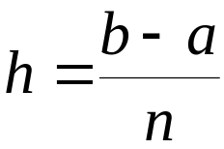
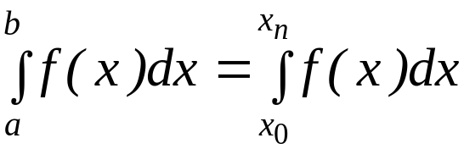


Multiple Segment Simpson’s 1/3rd Rule
Just like in multiple segment Trapezoidal Rule, one can subdivide the interval
[a, b] into n segments and apply Simpson’s 1/3rd Rule repeatedly over
every two segments. Note that n needs to be even. Divide interval
[a, b] into equal segments, hence the segment width
where
http://numericalmethods.eng.usf.edu

Slide 16
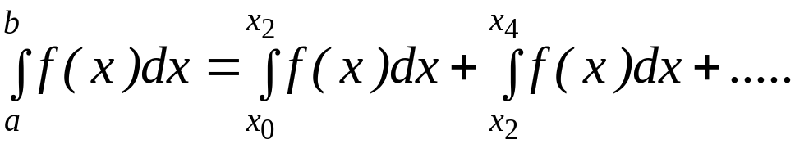
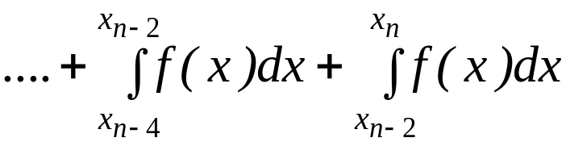
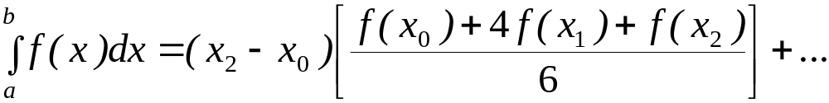
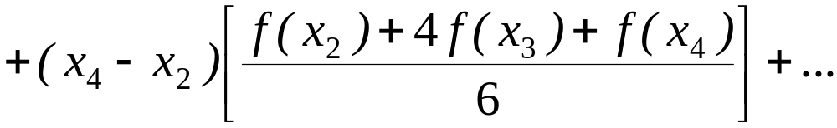
Multiple Segment Simpson’s 1/3rd Rule
f(x)
. . .
x
x₀
x₂
x_{n-2}
x_{n}
Apply Simpson’s 1/3rd Rule over each interval,
http://numericalmethods.eng.usf.edu

Slide 17
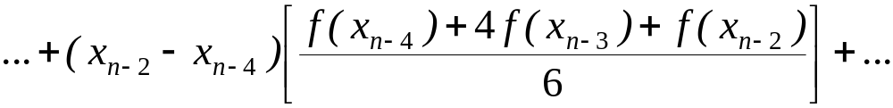
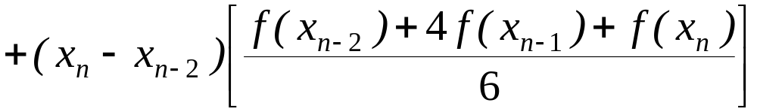


Multiple Segment Simpson’s 1/3rd Rule
Since
http://numericalmethods.eng.usf.edu

Slide 18
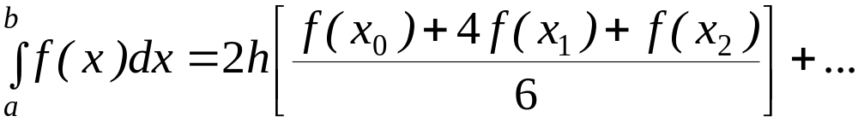
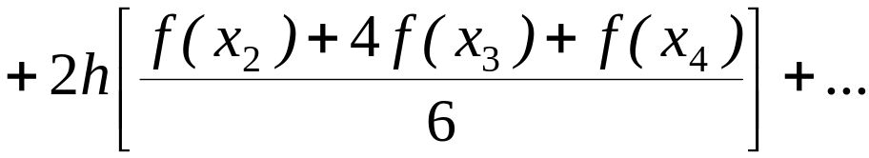
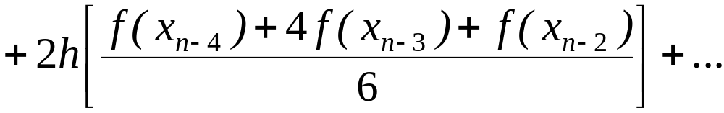
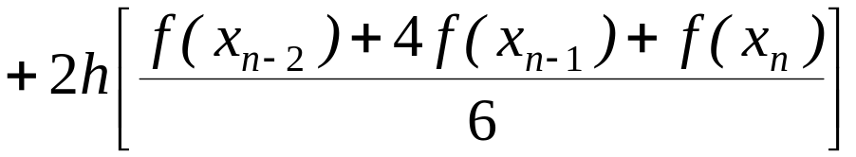
Multiple Segment Simpson’s 1/3rd Rule
Then
http://numericalmethods.eng.usf.edu

Slide 19
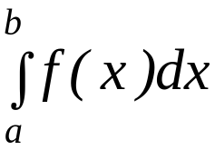
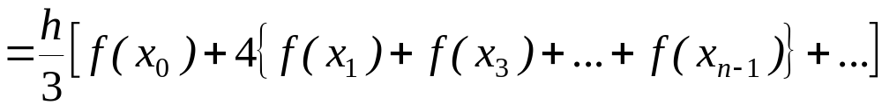
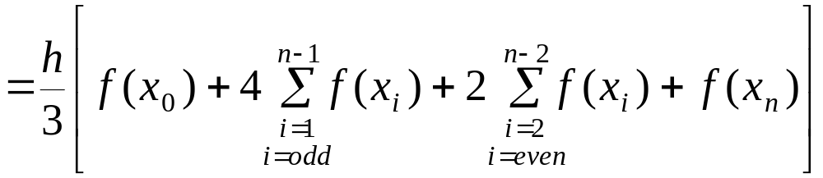
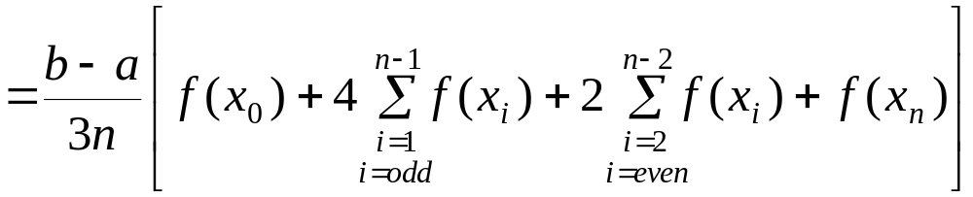
Multiple Segment Simpson’s 1/3rd Rule
http://numericalmethods.eng.usf.edu

Slide 20



Example 2
Use 4-segment Simpson’s 1/3rd Rule to approximate the distance
covered by a rocket from t= 8 to t=30 as given by
Use four segment Simpson’s 1/3rd Rule to find the approximate value of x.
Find the true error, for part (a).
Find the absolute relative true error, for part (a).
http://numericalmethods.eng.usf.edu

Slide 21
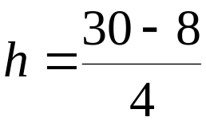










Solution
a)
Using n segment Simpson’s 1/3rd Rule,
So
http://numericalmethods.eng.usf.edu

Slide 22
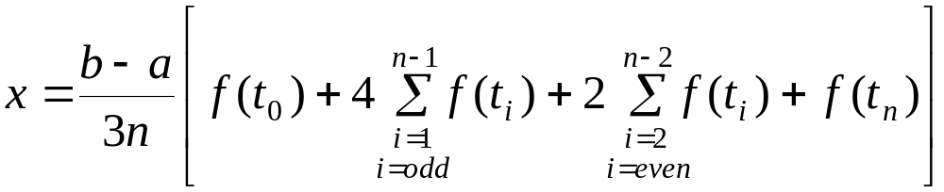
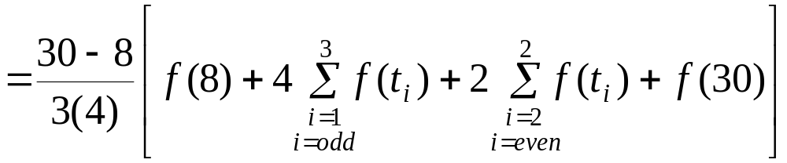
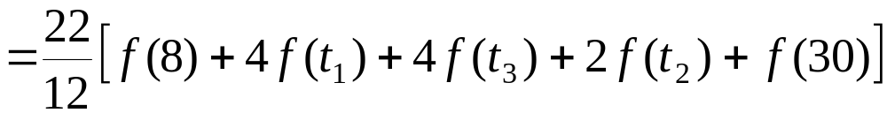
Solution (cont.)
http://numericalmethods.eng.usf.edu

Slide 23
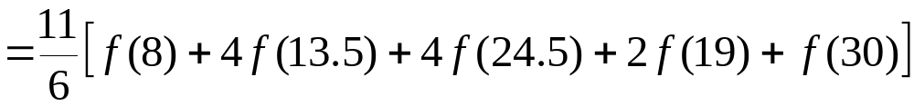

Solution (cont.)
cont.
http://numericalmethods.eng.usf.edu

Slide 24


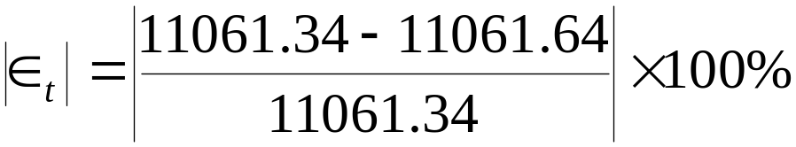

Solution (cont.)
In this case, the true error is
b)
The absolute relative true error
c)
http://numericalmethods.eng.usf.edu

Slide 25
Solution (cont.)
Table 1: Values of Simpson’s 1/3rd Rule for Example 2 with multiple segments
n | Approximate Value | E_{t} | |Є_{t} |
2 4 6 8 10 | 11065.72 11061.64 11061.40 11061.35 11061.34 | 4.38 0.30 0.06 0.01 0.00 | 0.0396% 0.0027% 0.0005% 0.0001% 0.0000%
http://numericalmethods.eng.usf.edu

